Slide 1
PROJECT TITLE
CAPSTONE PROJECT
Presented By: MAHESHWARAN B
Student Name : MAHESHWARAN B
College Name & Department : Velammal Engineering College &
B.E Computer science Engineering –(Cybersecurity)

Slide 2
OUTLINE
Problem Statement
Technology used
Wow factor
End users
Result
Conclusion
Git-hub Link
Future scope

Slide 3
Problem Statement
The objective of this project is to implement a simple encryption and decryption system using image steganography. The system should allow a user to hide a secret message inside an image by modifying its pixel values and later retrieve the message using a correct passcode. The encryption process involves mapping each character of the message to its corresponding ASCII value and embedding it into the image pixels. The decryption process extracts the hidden message by reversing the mapping, provided the user enters the correct passcode. The system should ensure that only authorized users with the correct passcode can retrieve the hidden message.

Slide 4
Technology used
Programming Language: Python – for implementing the encryption and decryption logic.
Computer Vision Library: OpenCV (cv2) – for image processing, reading, modifying, and saving images.
File Handling & OS Operations: OS module – for handling file operations and opening the encrypted image.
Character Encoding: ASCII encoding – for converting characters to numerical values and vice versa.
Data Structures: Dictionaries – for mapping characters to ASCII values and vice versa.

Slide 5
Wow factors
Steganography-Based Security: Hides messages inside an image, making it difficult for unauthorized users to detect the presence of hidden data.
Simple Yet Effective Encryption: Uses pixel manipulation to store the message, ensuring a lightweight yet functional encryption technique.
Passcode Protection: Adds an extra layer of security by requiring a correct passcode for decryption.
No Additional Storage Needed: Unlike text-based encryption methods, this approach does not require a separate encrypted file—data is stored directly within the image.
Cross-Platform Compatibility: Can be executed on different operating systems with minimal modifications.
Fun and Practical Application: Can be used for secret communication, watermarking, or protecting confidential data in a creative way.

Slide 6
End users
Cybersecurity Enthusiasts: Individuals interested in encryption, data security, and steganography techniques.
Journalists & Whistleblowers: People who need to transmit sensitive information securely without drawing attention.
Government & Defense Agencies: For secure communication and covert data transmission.
Researchers & Academicians: Those studying cryptography and steganography for educational or research purposes.
Corporate Professionals: Businesses looking to protect confidential documents and sensitive data.
Developers & Hobbyists: Programmers exploring image processing and encryption techniques for innovative applications.
General Users: Anyone who wants to hide personal messages or protect their private information in an unconventional way.

Slide 7
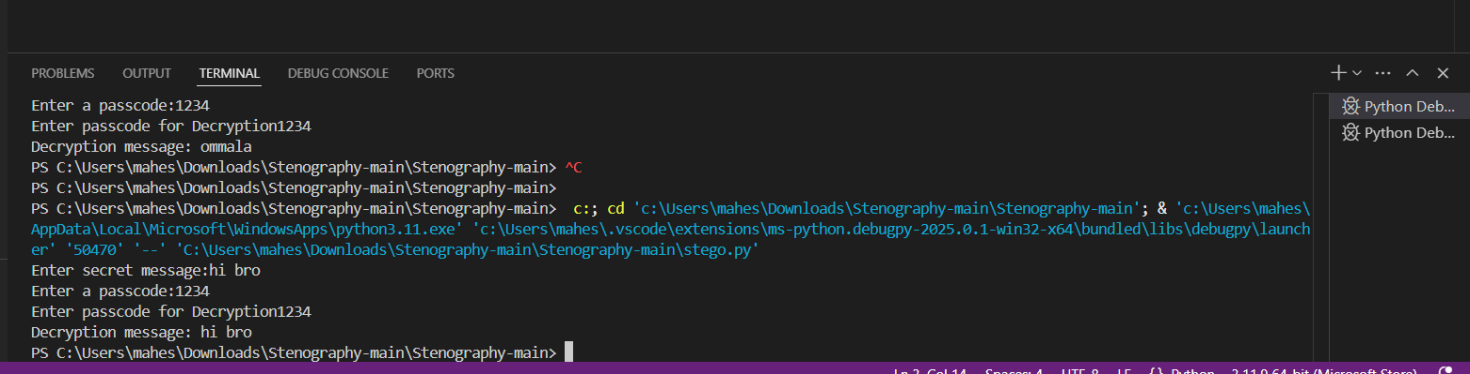
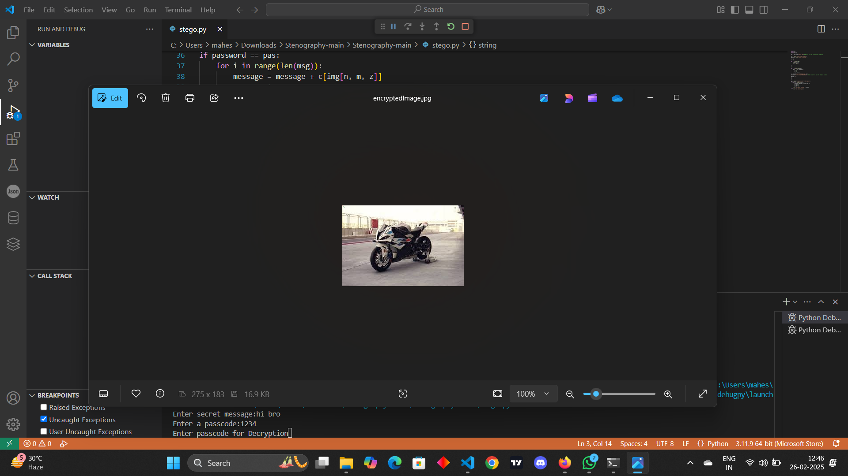
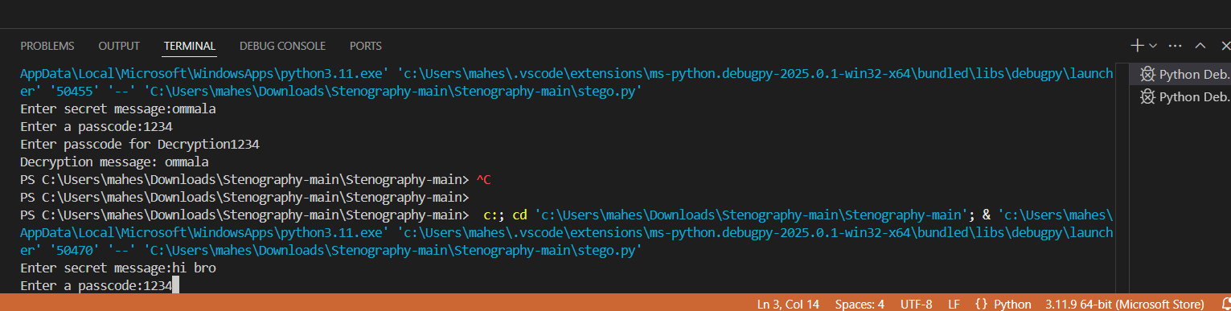
Results

Slide 8
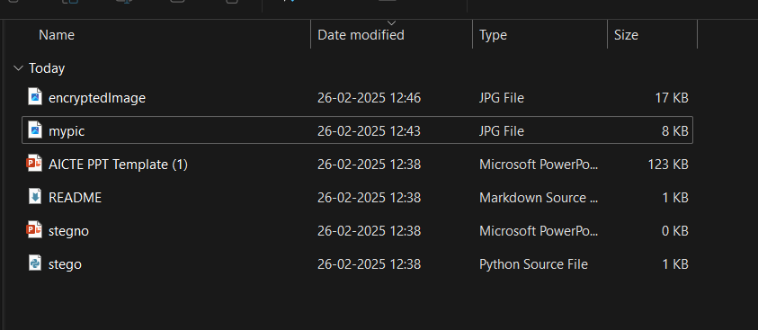

Slide 9
Conclusion
This project demonstrates a simple yet effective approach to secure message transmission using image steganography. By embedding secret messages within an image's pixel values and protecting access with a passcode, it ensures confidentiality while maintaining the original image’s appearance. The combination of Python, OpenCV, and ASCII encoding makes it an accessible and efficient method for secure communication. With applications in cybersecurity, journalism, and corporate security, this technique showcases the power of steganography in protecting sensitive information. Future enhancements could include improved encryption algorithms, support for larger messages, and integration with different image formats to increase security and usability.

Slide 10
GitHub Link
https://github.com/maheshwaran70/steganography.git

Slide 11
Future scope(optional)
Advanced Encryption Techniques: Integrate stronger encryption algorithms like AES or RSA to enhance security before embedding messages into the image.
Support for Larger Messages: Optimize data embedding techniques to store longer messages without significantly altering the image quality.
Multiple Image Formats: Extend support to various image formats (PNG, BMP, TIFF) for better compatibility and reduced compression losses.
Steganalysis Resistance: Improve the technique to prevent detection through steganalysis tools, making hidden data even more secure.
Graphical User Interface (GUI): Develop a user-friendly GUI for easier encryption and decryption without needing coding knowledge.
Audio & Video Steganography: Expand the project to hide messages within audio and video files for enhanced security applications.
Cloud-Based Implementation: Implement a cloud-based version where users can upload images, encrypt/decrypt messages, and download secure files.
Multi-Layered Security: Introduce multi-factor authentication (MFA) for decryption, requiring both a password and another verification method.
Real-World Applications: Adapt the project for practical use cases like secure digital watermarking, copyright protection, and secure communication for defense and journalism.
Mobile App Integration: Develop an Android/iOS application to allow users to encrypt and decrypt messages on their smartphones.

Slide 12
THANK YOU

